Slide 1
Exp 10
D-Flip Flop

Slide 2
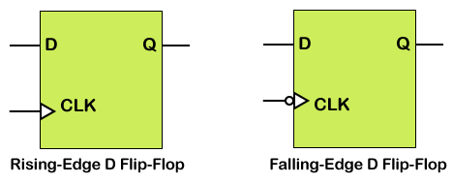
D Flip-Flop
A D flip-flop is a sequential element that follows the input pin d at the clock's given edge. D flip-flop is a fundamental component in digital logic circuits.
There are two types of D Flip-Flops being implemented: Rising-Edge D Flip Flop and Falling-Edge D Flip Flop.
D flip flop is an edge-triggered memory device that transfers a signal's value on its D input to its Q output when an active edge transition occurs on its clock input. Then, the output value is held until the next active clock cycle.

Slide 3
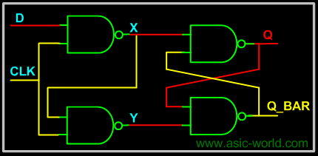
D Flip-Flop using NAND GATES
module dff_from_nand();
wire Q,Q_BAR;
reg D,CLK;
nand U1 (X,D,CLK) ;
nand U2 (Y,X,CLK) ;
nand U3 (Q,Q_BAR,X);
nand U4 (Q_BAR,Q,Y);
// Testbench
initial begin
$monitor("CLK = %b D = %b Q = %b Q_BAR = %b",CLK, D, Q, Q_BAR);
CLK = 0;
D = 0;
#3 D = 1;
#3 D = 0;
#3 $finish;
end
always #2 CLK = ~CLK;
endmodule

Slide 4
D Flip-Flop
Flip flops are inferred using the edge triggered always statements. The always statement is edge-triggered by including either a posedge or negedge clause in the event list. Here are some examples of sequential always statements, such as:
always @(posedge Clock)
always @(negedge Clock)
always @(posedge Clock or posedge Reset)
always @(posedge Clock or negedge Reset)
always @(negedge Clock or posedge Reset)
always @(negedge Clock or negedge Reset)
If an asynchronously reset flip flop is being modeled, a second posedge or negedge clause is needed in the event list of the always statement.
Also, most synthesis tools require that the reset must be used in if statement directly following the always statement, or after begin if it is in a sequential begin-end block.
REF: https://www.javatpoint.com/verilog-d-flip-flop

Slide 5
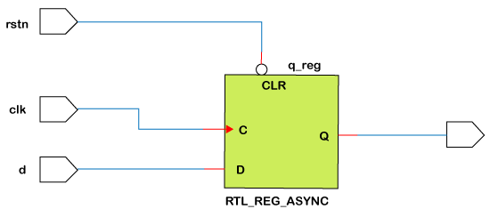
D flip flop with Asynchronous Reset
D flip-flops can have asynchronous reset, which can be independent of the clock. Regardless of the clock, the reset can change the output Q to zero, which can cause asynchronous output.
// Design Module
module Adff(d,rstn,clk,q);
input d,rstn,clk;
output reg q;
always@(posedge clk or negedge rstn)
if (!rstn )
q<=0;
else
q<=d;
endmodule

Slide 6
Test bench
integer i;
initial begin
clk =0; d =0; rstn =0;
#5 rstn =1;
repeat(6) begin
d =$urandom_range(0,1);
#5;
end
rstn = 0;
//#5 rstn = 1;
repeat(6) begin
d =$urandom_range(0,1);
#5;
end
$finish;
end
endmodule
module tv_dff;
reg d,rstn,clk;
Adff obj(d,rstn,clk,q);
always #10 clk = ~clk;
initial begin
$display(" T\treset \t clk \t D \t| q");
$monitor(" %0t \t %d \t %d \t %d | %d",$time,rstn,clk,d,q);
end

Slide 7
D flip flop with synchronous Reset
D flip-flop with synchronous reset means the output can reset to zero with the reset input but only with the clock, which makes the reset input dependent on the clock pulse; without clock pulse reset will not be able to set the output Q to zero, which will give you a synchronous output always.
// Design Module
module Sdff(d,rstn,clk,q);
input d,rstn,clk;
output reg q;
always@(posedge clk)
if (!rstn )
q<=0;
else
q<=d;
endmodule

Slide 8
Test bench
integer i;
initial begin
clk =0; d =0; rstn =0;
#5 rstn =1;
repeat(6) begin
d =$urandom_range(0,1);
#5;
end
rstn = 0;
//#5 rstn = 1;
repeat(6) begin
d =$urandom_range(0,1);
#5;
end
$finish;
end
endmodule
module tv_dff;
reg d,rstn,clk;
Sdff obj(d,rstn,clk,q);
always #10 clk = ~clk;
initial begin
$display(" T\treset \t clk \t D \t| q");
$monitor(" %0t \t %d \t %d \t %d | %d",$time,rstn,clk,d,q);
end

